Slide 1
TITLE: Named entity recognition (NER)
TEAM MEMBERS:
Manichand_2010030455
HARSHa_2010030173
PRAKASH _2010030533
Dileep _2010030416

Slide 2
Table of Contents
ABSTRACT
Project Area
Literature Survey
Problem Statement
Conclusion
Suggestions
Thank you

Slide 3
With the increase in availability of data, extraction of useful information from this data has become most important activity across all domains. When the data is available as documents written in natural language, information extraction becomes more challenging. Named Entity recognition (NER) is a technique used extensively for automatic extraction of useful information from unstructured natural language document collections. Used both, for web applications as well as stand-alone systems, NER is considered as one of the major step in Natural Language Processing (NLP) for analysis of text. This paper discusses basics of NER, various algorithms used for NER and major applications and challenges in the field of NER.
Keywords: Named Entity Recognition, Information Extraction, Natural Language Processing, Part of Speech.
ABSTRACT:

Slide 4
In natural language processing, named entity recognition (NER) is the problem of recognizing and extracting specific types of entities in text. Such as people or place names. In fact, any concrete “thing” that has a name. At any level of specificity. Job titles, public school names, sport names, music album names, musician names, music genres.
PROBLEM
AREA:

Slide 5
We did a literature review from several textbooks, tutorials, and papers.
Textbook:
After going through the IR textbook, we found no chapters or sections explicitly introduce how to do
NER. The term NER is mentioned only two times in Chapter 10 and Chapter 15.
We also checked other two famous NLP text books, “Foundation of Statistical NLP” and “Speech and Language Processing”.
Papers and Tutorials:
We also found a few good papers about NER. A survey of existing NER technologies is presented by Nadeau and Sekine [1]. Zhou and Su [2] proposed a HMM-based chunk tagger for NER. Ratinov and Roth [3] investigated the common challenges and misconceptions in NER, and proposed corresponding solutions.
Reference : https://vtechworks.lib.vt.edu/bitstream/handle/10919/52254/ReportNER.pdf
Literature
Survey

Slide 6
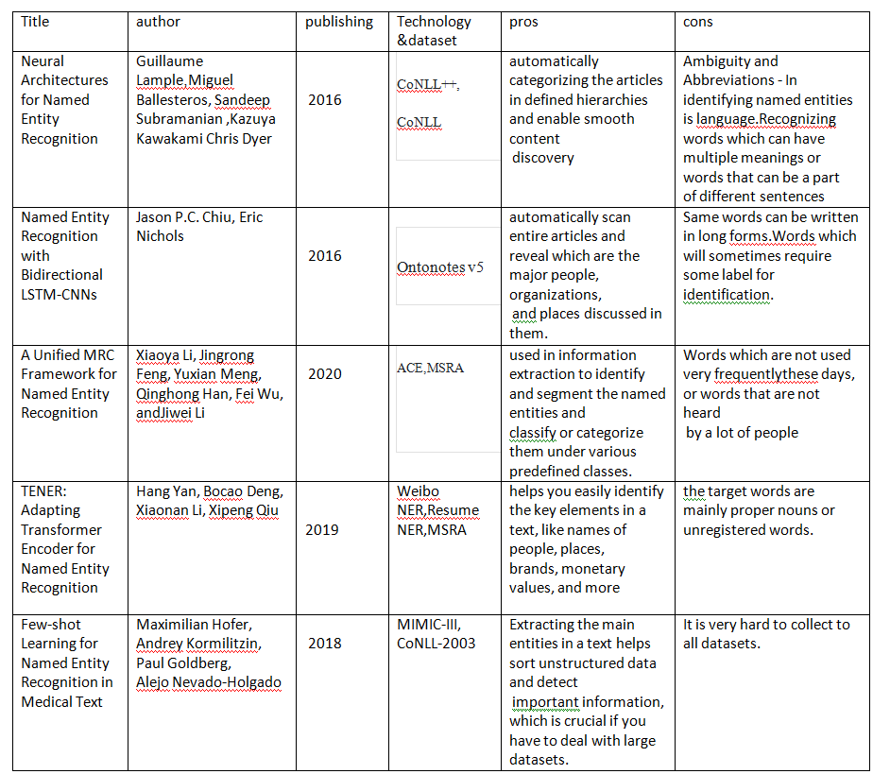

Slide 7
Named Entity Recognition (NER) is a natural language processing task that attempts to find named entities (persons, locations, organizations, etc.) within a text. Since the tag of one word depends on neighboring words (and their tags), the problem is modeled as a sequence labeling task, wherein a sentence is considered as an input, and the goal is to produce the tags of all words jointly, so as to maximize accuracy.
PROBLEM STATEMENT:

Slide 8
Named Entity Recognition, a sub process of natural language processing, plays very important role in automated information extraction NER is suited to any situation in which a high-level overview of a large quantity of text is helpful. With NER, you can, at a glance, understand the subject or theme of a body of text and quickly group texts based on their relevancy or similarity..
Conclusion:

Slide 9
THANK YOU

